Slide 1
McBIM – Samples characterization
Version 1
June 29, 2018
Gaël LOUBET

Slide 2
Table of contents
Samples for dielectric characterization
Samples for fast prototyping
Samples for experimental validation

Slide 3
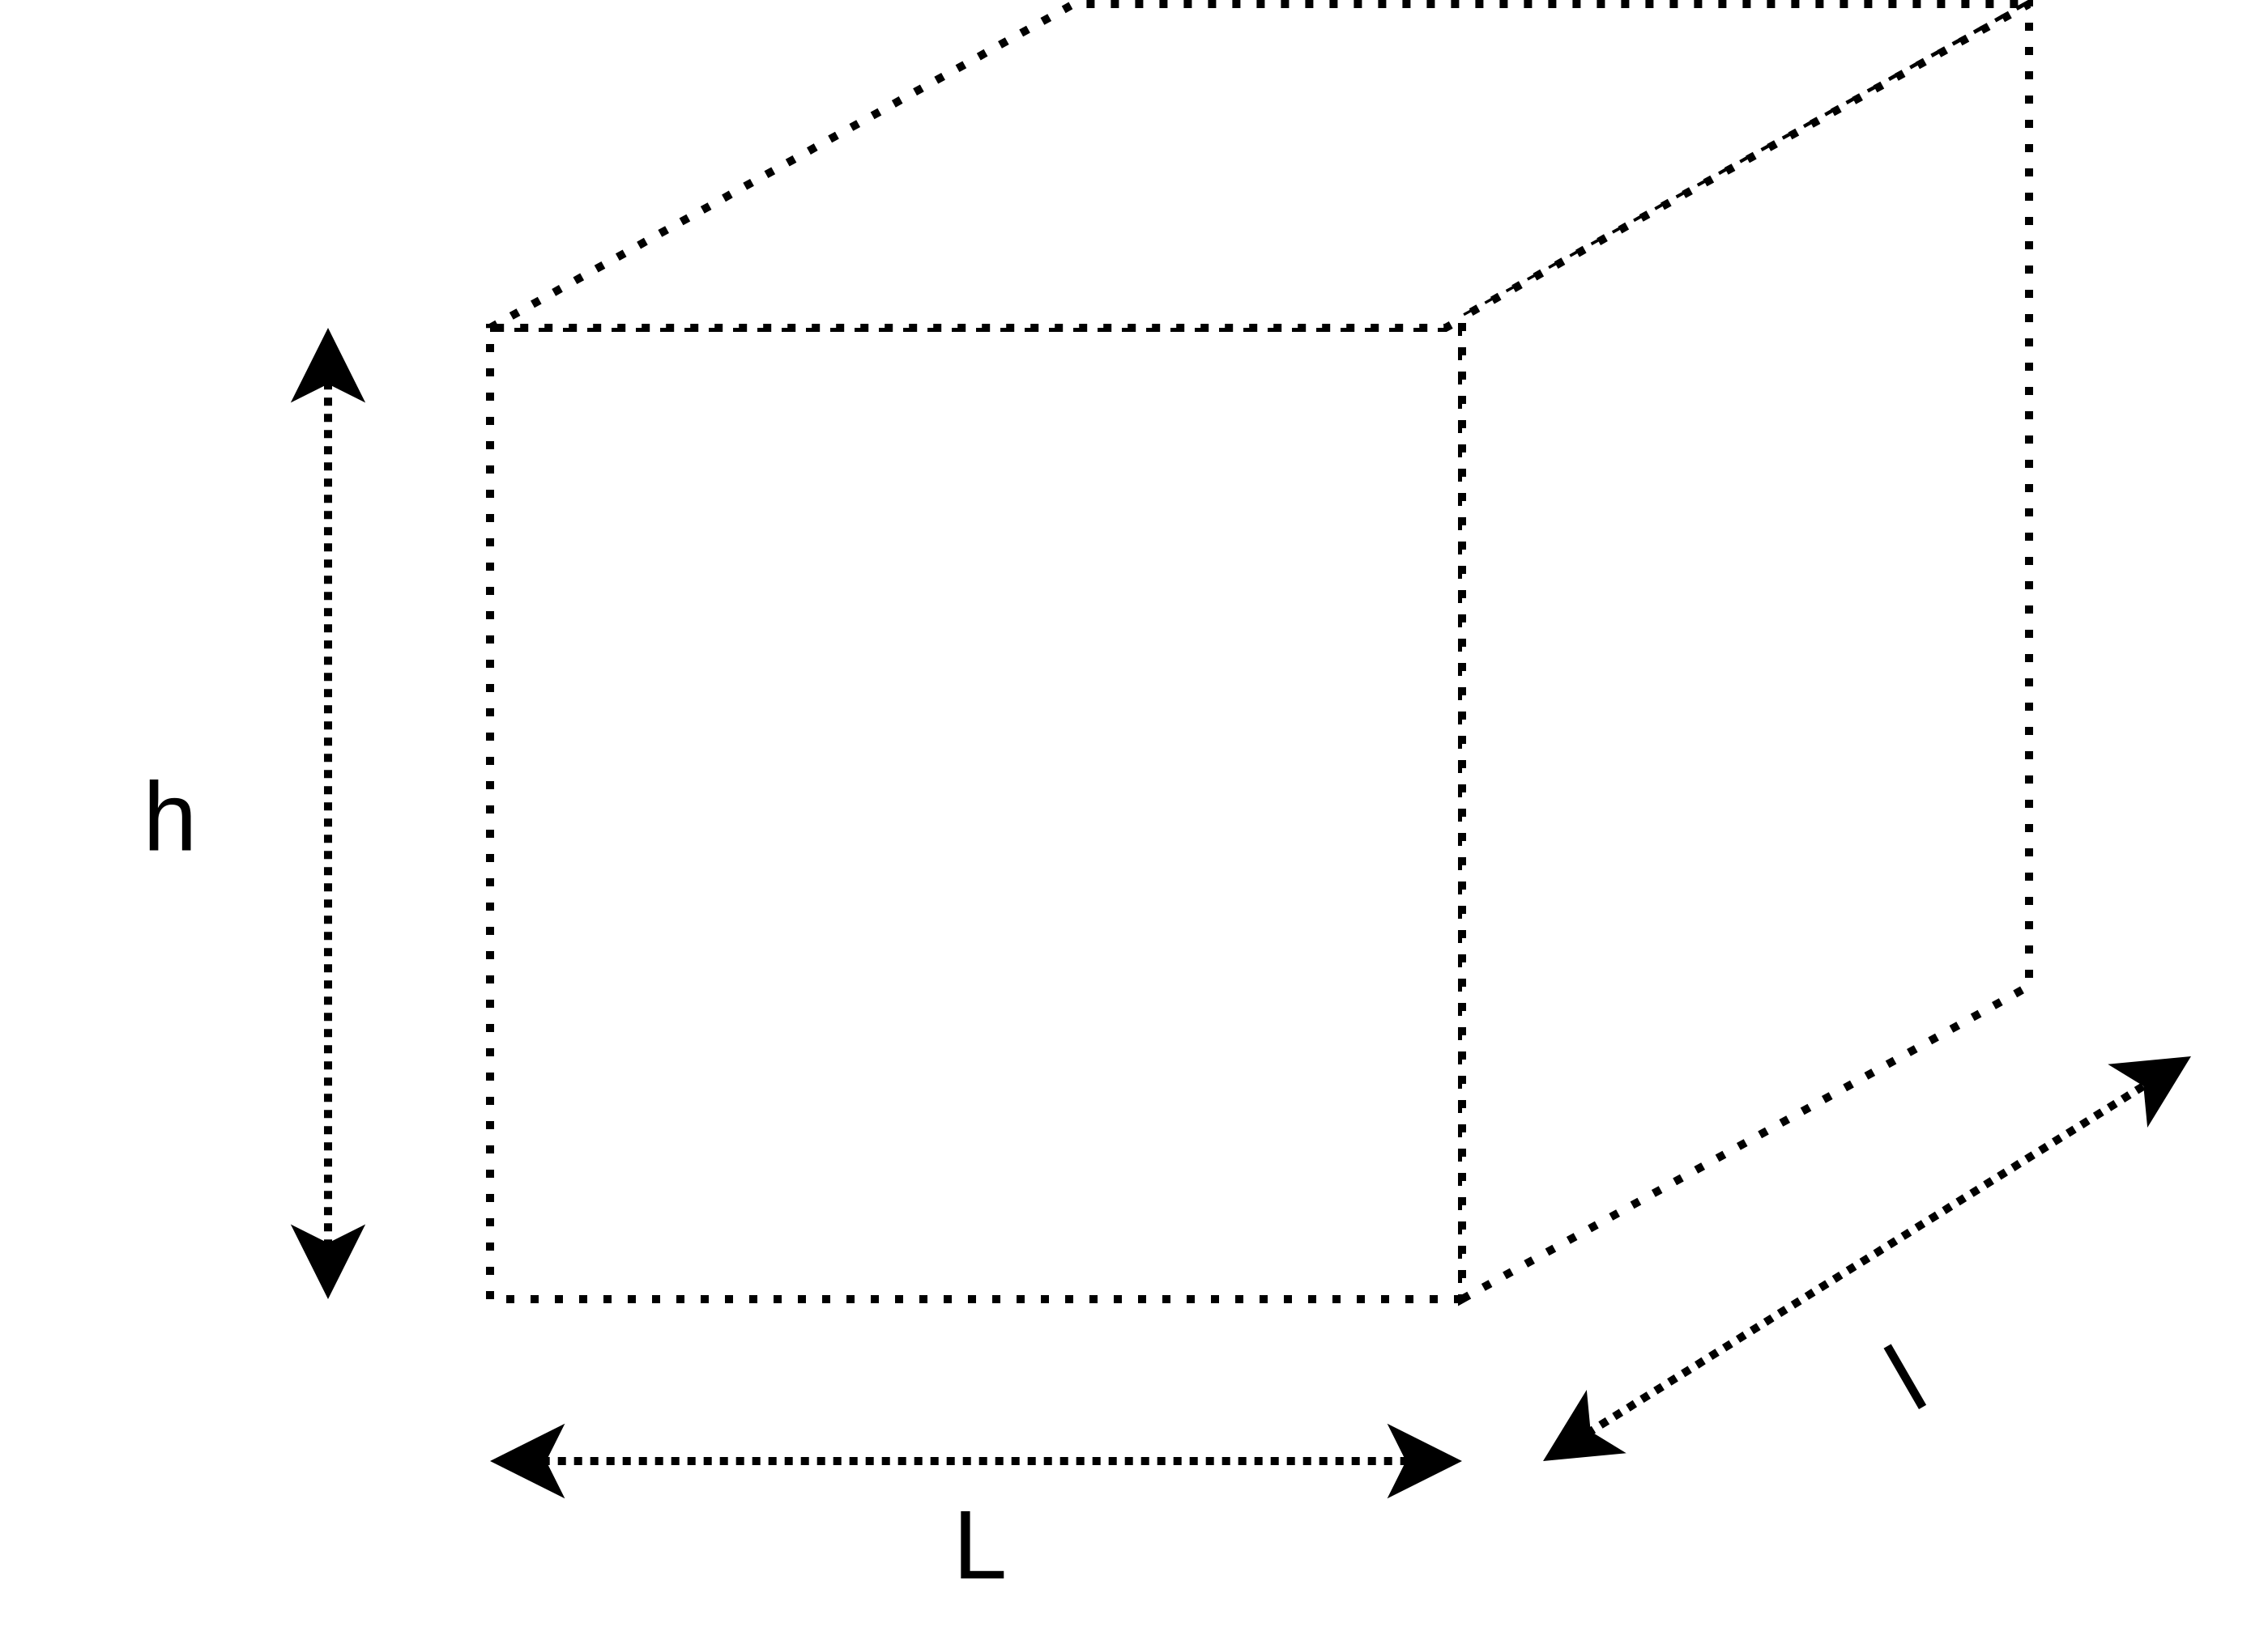
Samples for dielectric characterization
Objective: dielectric characterization, perhaps through open-ended probe technic
Parameters: Materials:
L > α.λ Concrete
l > α.λ Reinforced concrete
h > α.λ Fibered concrete
(vegetal, synthetic, metallic)
Representative compositions
(extrema, average,…)
α~1
Quantities: at least one sample per composition
Few ISM frequencies and associated wavelengths:
125khz: λ=2398.3m
13.56Mhz: λ=22.11m
433Mhz: λ=69.2cm
868Mhz: λ=34.5cm
915Mhz: λ=32.8cm
2.45Ghz: λ=12.2cm
5.8Ghz: λ=5.2cm

Slide 4
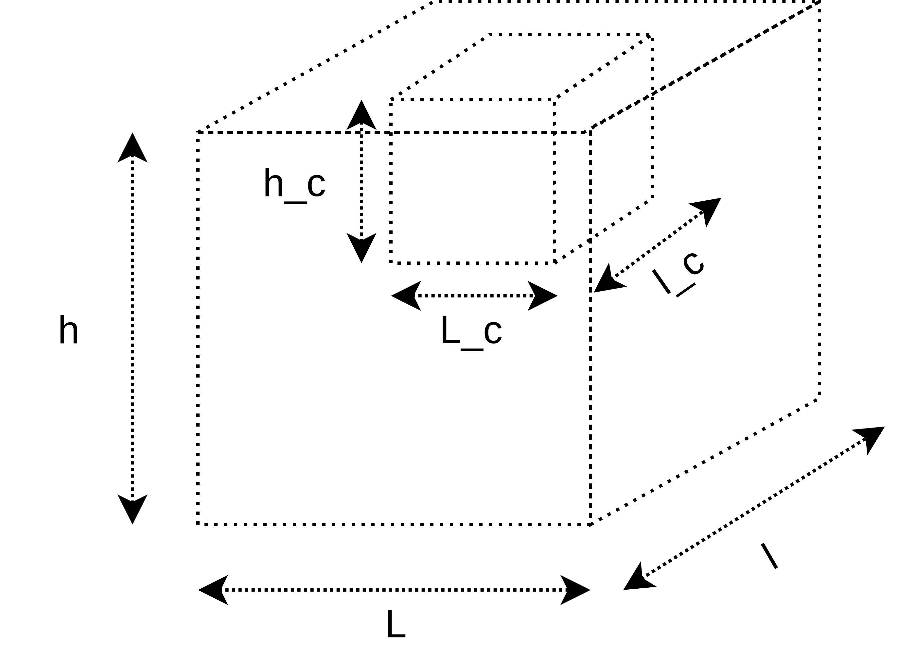
Samples for fast prototyping
Objective: fast prototyping
Parameters: Materials:
L > α.λ More representative reinforced
l > α.λ concrete compositions
h > α.λ
α~1
L_c ~ λ/4
l_c ~ λ/4
h_c ~ λ/4
Quantities: at least one sample, with cap
Maybe with pieces of concrete to diminuate the volume of the cavity
Few ISM frequencies and associated wavelengths:
125khz: λ=2398.3m
13.56Mhz: λ=22.11m
433Mhz: λ=69.2cm
868Mhz: λ=34.5cm
915Mhz: λ=32.8cm
2.45Ghz: λ=12.2cm
5.8Ghz: λ=5.2cm

Slide 5
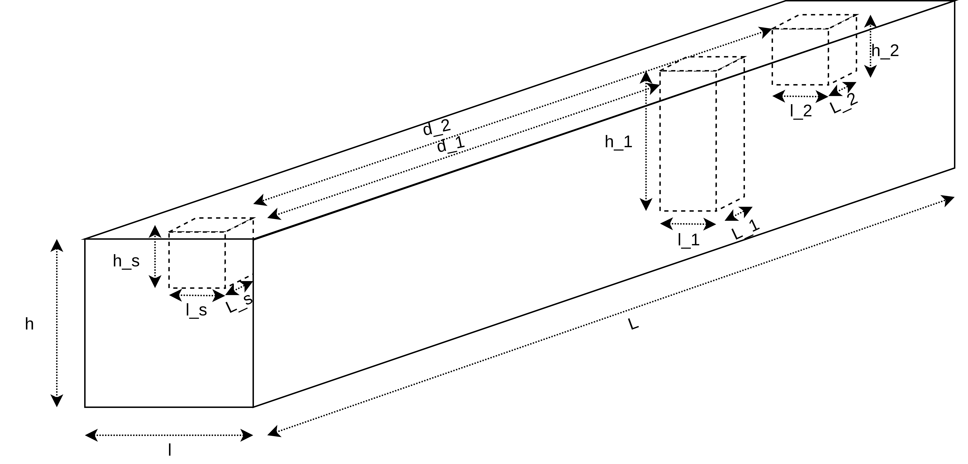
Samples for experimental validation
Objective: experimental validation
Parameters: Material:
Structure: More representative composition of reinforced concrete
L: few meters
L: around meter
h: around meter
Communicating node cavity:
L_s
l_s
h_s
Sensitive node n°1 cavity:
L_1
l_1
H₁
d_1
Sensitive node n°2 cavity:
L_2
l_2
h_2
D₂
…
Quantities: at least one sample
Cavities: How much? Each 50cm? In structure heart?
With caps to close them.

